Slide 1

Opioid Addiction
UPDATE
Local Impact
in a National Crisis

Slide 2
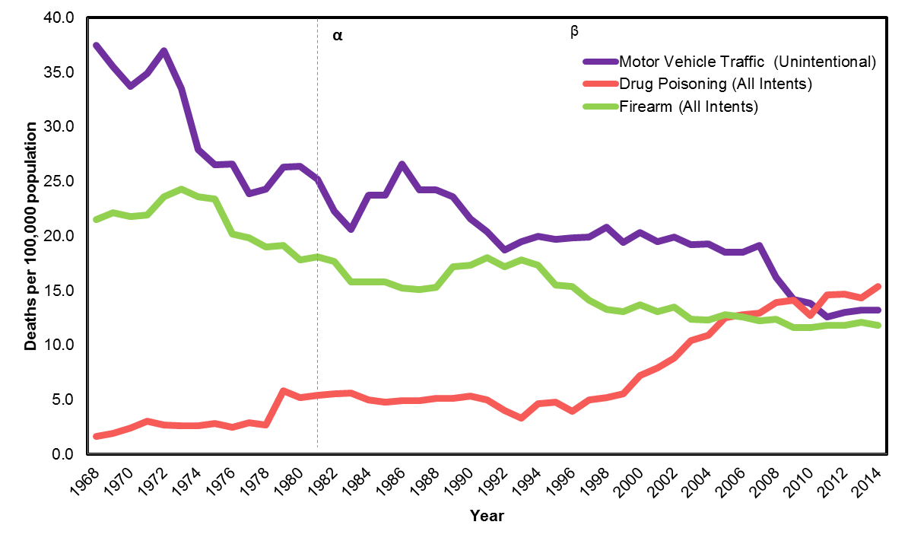


NC Death Rates
*Per 100,000, age-adjusted to the 2000 U.S. Standard Population
α - Transition from ICD-8 to ICD-9
β – Transition from ICD-9 to ICD-10
Notes:
Panel:
Tammy Shook, Buncombe County Social Work Division Director
Dr. Craig Martin, Chief Medical Officer for Vaya Health
Dr. Jim Hartye, Mission Health
Sonya Greck, Mission Health
Dr. Courtenay Wilson, MAHEC

Slide 3
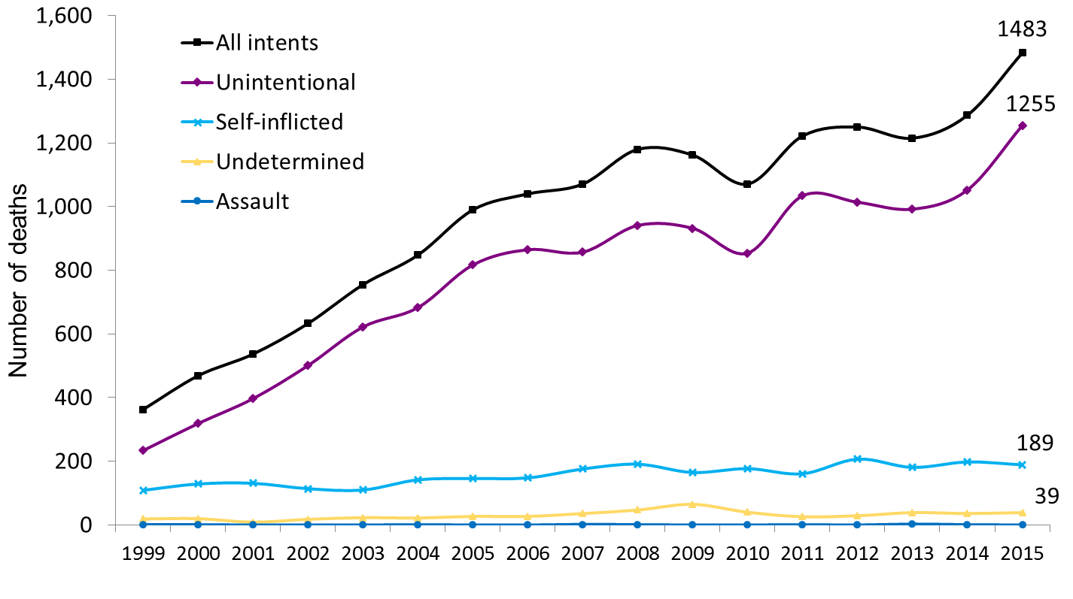
Medication or Drug Overdose Deaths by Intent
North Carolina Residents, 1999-2015*
Source: N.C. State Center for Health Statistics, Vital Statistics-Deaths, 1999-2015 (*2015 PROVISIONAL)
Analysis by Injury Epidemiology and Surveillance Unit
Medication or drug overdose: X40-X44, X60-X64, Y10-Y14, X85

Slide 4
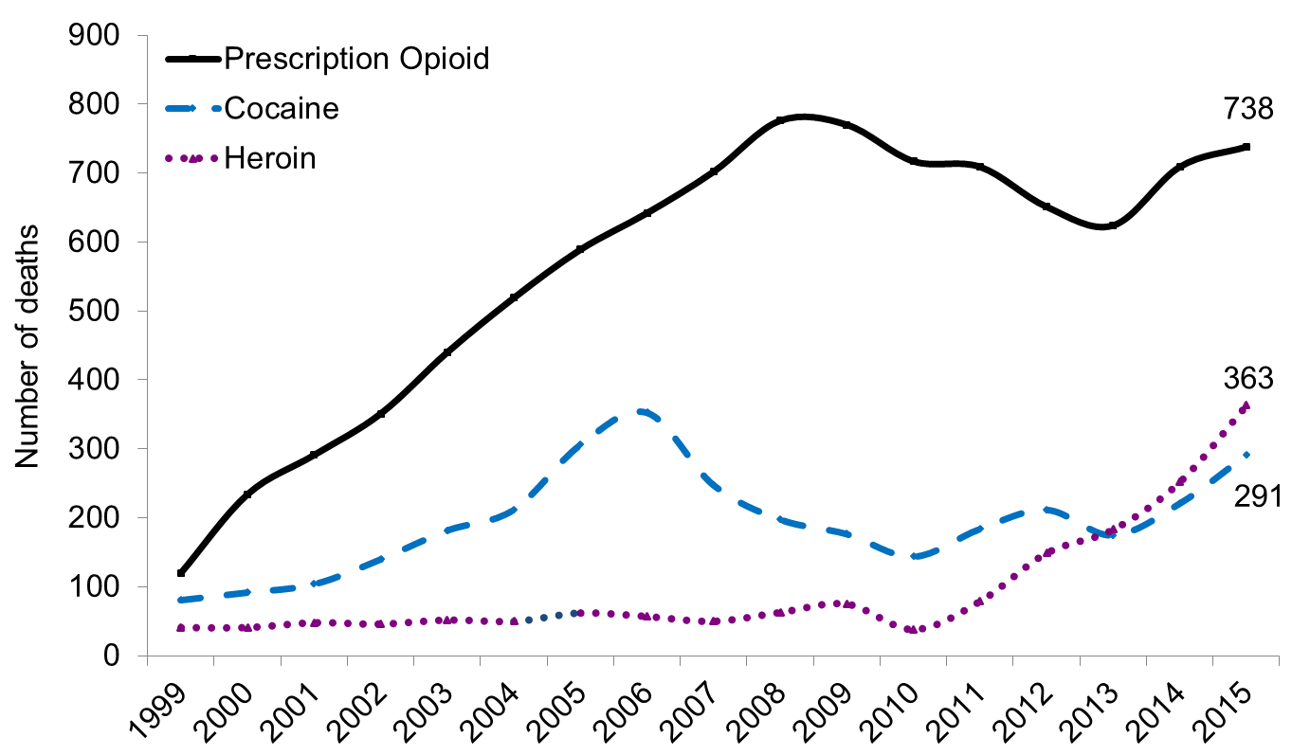

Medication/Drug Overdose Deaths in NC
Source: N.C. State Center for Health Statistics, Vital Statistics-Deaths, 1999-2015
*2015 Provisional Data (August 2016)
Analysis by Injury Epidemiology and Surveillance Unit

Slide 5
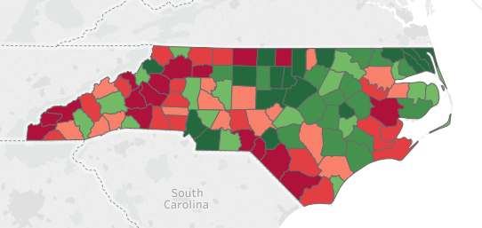
Opioid Prescribing Rates by County
2016
http://www.ncdhhs.gov/divisions/mhddsas/ncdcu/Prescription-Rates-by-County
Notes:
2015 Numbers
Macon County has the highest numbers: 1.051 Rx per resident with population of 34,201. 257.8 pills per person. Orange County has lowest numbers: .5 Rx per resident with population of 141,354 and 32.3 pills/resident.
These are 2015 numbers.
Surrounding Counties:
Henderson #99. 204.4 pills/resident. 1.020 Rx per resident. Population = 112,655
Rutherford: #95. 121.9 pills/resident. 1.369 Rx per resident. Population = 66,390
McDowell: #97. 133.7 pills/resident. 1.394 Rx per resident. Population = 44,989
Yancey: #74. 92 pills/resident. 1.320 Rx per resident. Population = 17,587
Madison: #55. 76.4 pills/resident. 1.067 Rx per resident. Population = 21,139
Haywood: #71. 89.9 pills/resident. 1.267 Rx per resident. Population = 59,868
Transylvania: #51. 73.4 pills/resident. 1.021 Rx per resident. Population = 33,211

Slide 6
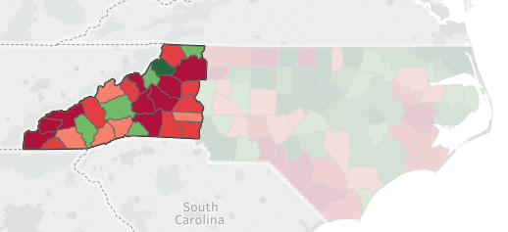
Opioid Prescribing Rates by County
2016
http://www.ncdhhs.gov/divisions/mhddsas/ncdcu/Prescription-Rates-by-County
Notes:
Macon County has the highest numbers: 1.051 Rx per resident with population of 34,201. 257.8 pills per person. Orange County has lowest numbers: .5 Rx per resident with population of 141,354 and 32.3 pills/resident.
These are 2015 numbers.
Surrounding Counties:
Henderson #99. 204.4 pills/resident. 1.020 Rx per resident. Population = 112,655
Rutherford: #95. 121.9 pills/resident. 1.369 Rx per resident. Population = 66,390
McDowell: #97. 133.7 pills/resident. 1.394 Rx per resident. Population = 44,989
Yancey: #74. 92 pills/resident. 1.320 Rx per resident. Population = 17,587
Madison: #55. 76.4 pills/resident. 1.067 Rx per resident. Population = 21,139
Haywood: #71. 89.9 pills/resident. 1.267 Rx per resident. Population = 59,868
Transylvania: #51. 73.4 pills/resident. 1.021 Rx per resident. Population = 33,211

Slide 7
53% of the 30 Highest Counties
60% of the 10 Highest Counties
154,152,903
Notes:
Total number of pills in the West = 154,152,903

Slide 8
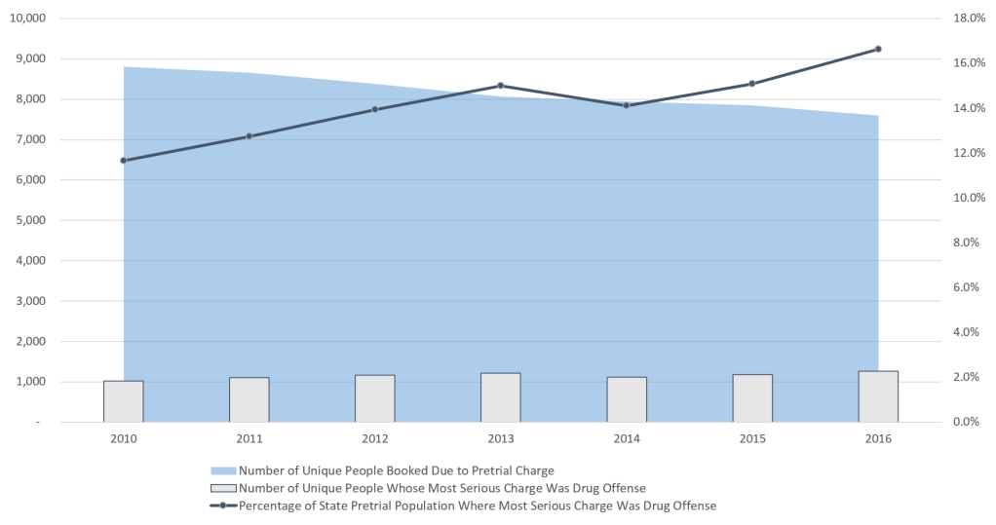
Drug Offenses and Jail Population
Source: Buncombe County Detention Center
Notes:
Most serious charge was a drug offense in pre-trial charge data.

Slide 9
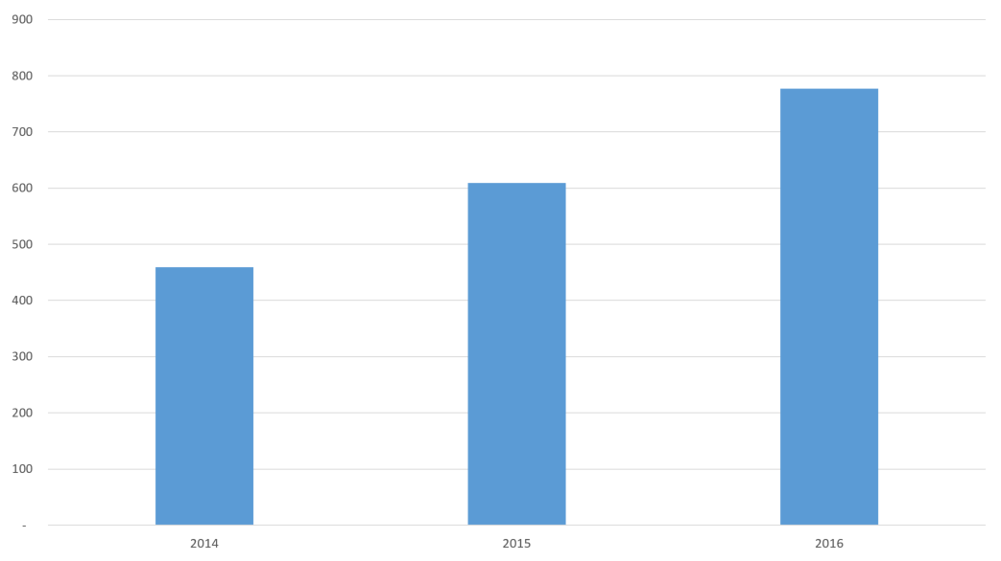
Inmates on Detox Protocol
Source: Buncombe County Detention Center
Notes:
Provided by jail medical provider (Transform Health)

Slide 10
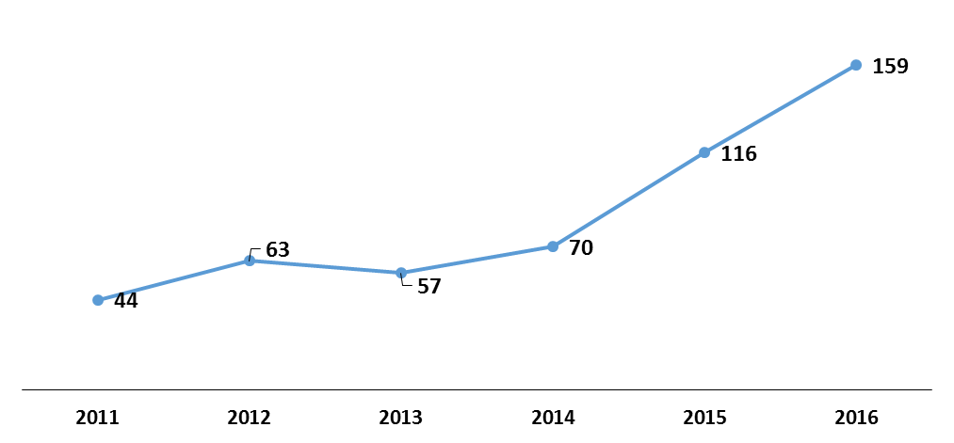

EMS Narcan Usage
*
*Patients with Overdose or Substance Abuse as primary/secondary reason for call
Notes:
127% Increase over 2014

Slide 11
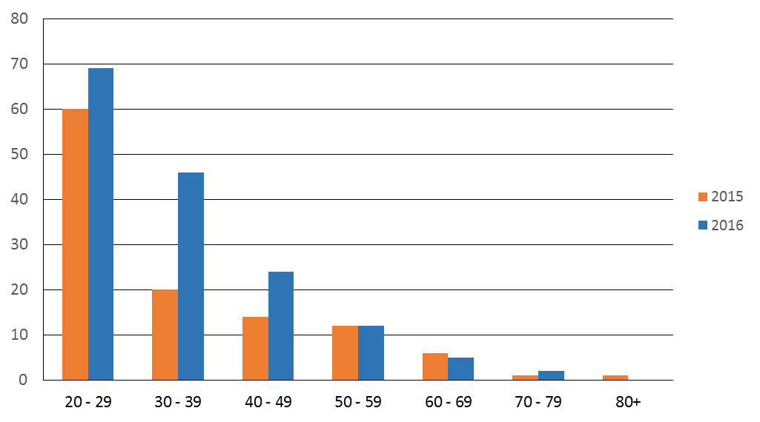
Narcan Administration by Age
*
*Suspected Overdose/Substance Abuse
Notes:
In January and February of 2017, Buncombe County EMS and County Emergency Transport Agencies reported 151 opioid related responses, 20 deceased patients, with 101 instances of narcan administration by either EMS or bystanders.

Slide 12
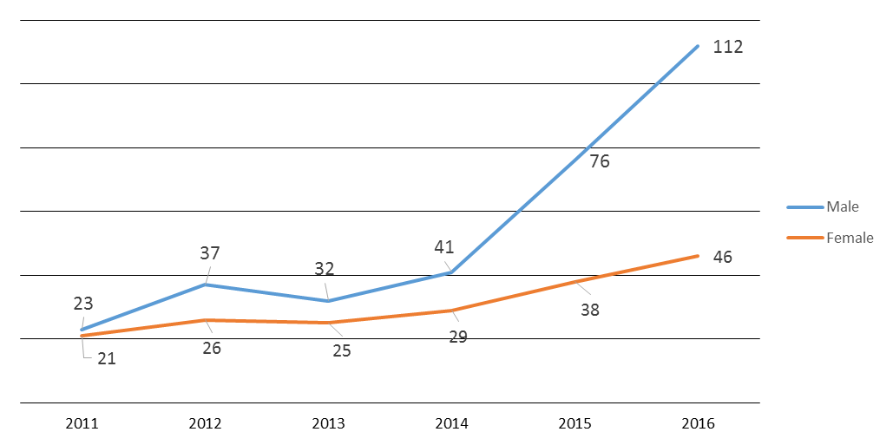
Narcan Administration by Gender
*
*Suspected Overdose/Substance Abuse
Notes:
In January and February of 2017, Buncombe County EMS and County Emergency Transport Agencies reported 151 opioid related responses, 20 deceased patients, with 101 instances of narcan administration by either EMS or bystanders.
Mission ED narcan usage for opioid poisoning cases increased 74% between 2015 and 2016 (39 to 68)

Slide 13
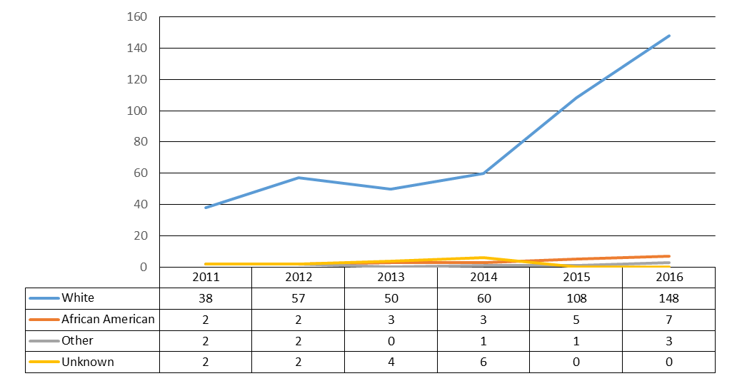
Narcan Administration by Race
*
*Suspected Overdose/Substance Abuse
Notes:
94% White, 4% African American, 2% Other

Slide 14
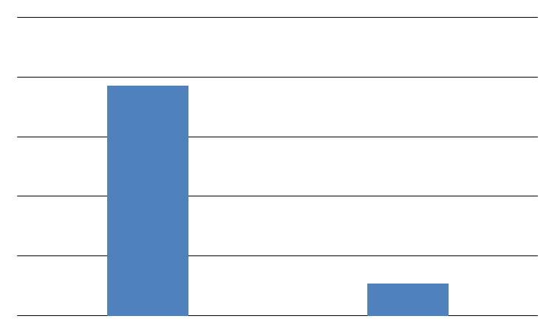
Medicaid Analysis – Females 14 – 44 (CCWNC Network)
> 12 narcotic Rx refills in last 12 months
At least 10 ED visits in last 12 months
No Cancer indicator
19,272
14%
1,966
Women 14 – 44
Chronic Pain

Slide 15
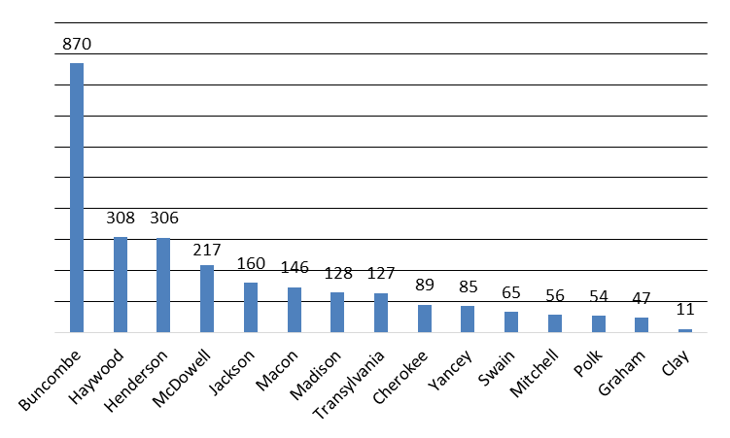
Chronic Pain Medicaid Patients by County (Females 14 – 44)
> 12 narcotic Rx refills in last 12 months
At least 10 ED visits in last 12 months
No Cancer indicator
Source: CCWNC

Slide 16


Slide 17

Education
Provider Education
Vaya
MAHEC
Mission Health
Community Care of Western NC
Western Carolina Medical Society

Slide 18
Education
Community Education
School Nurses
Homework Diner with Schools
Harm Reduction Strategies
Community Paramedic Model
Community Pharmacy Collaboration & Education
PharmD students at UNC-Asheville
Town Hall Forums

Slide 19


Slide 20

Media Campaign
Paid Media
In-kind support
Leverage media across the region
Multiple points of access
Link to CDC “Turn the Tide” national campaign
Focus on prevention
Begin now

Slide 21

Withdrawal
Crisis

Slide 22
Hospitalization Associated with Drug Withdrawal in Newborns
604% increase from 2004 to 2013
Source: N.C. State Center for Health Statistics, 2004-2013
Analysis: Injury Epidemiology and Surveillance Unit
Notes:
Do we have Buncombe #s?

Slide 23
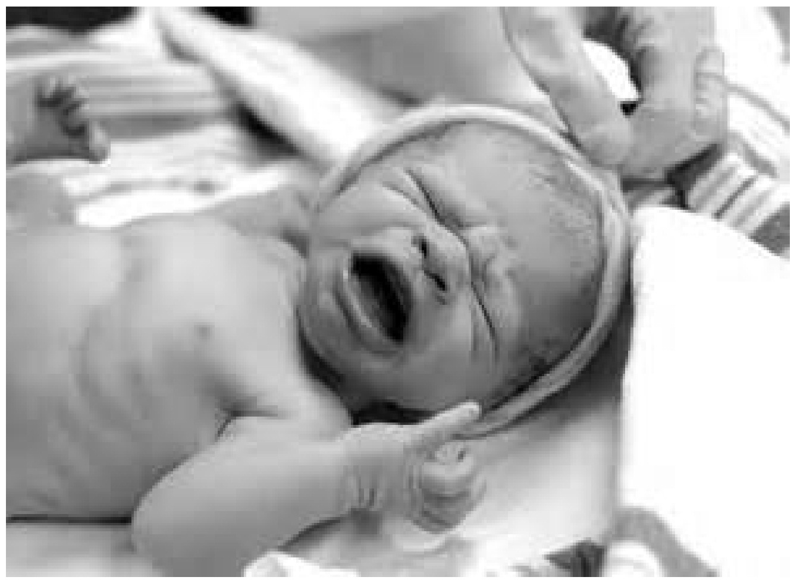
Local Impact
399 babies delivered at Mission Hospital with a positive toxicology
154 of those babies are in Buncombe County.

Slide 24

How Do We Turn The Tide?
Notes:
Equivalent of 15 caseloads for CPS Investigators under state standards

Slide 25

Treat the Mothers and the Babies Together
Help as soon as possible
Link to residential treatment
Provide supports in prenatal care and post natal care
Critical to support the bond between a mother and her child
Always keep the baby safe
Recovery is for life

Slide 26

A Continuum of Substance Use Care
Residential Treatment
Close Monitoring
Life Skills Training
Work Supports
Child Care
Sibling Care
Transitional Care
Peer Support

Slide 27

A Continuum of Substance Use Care
Enhancing Health
Primary Prevention
Early Intervention
Treatment
Recovery Support
Notes:
Primary Prevention:
School programming and education
Preconception Counseling
Primary Care Medical Home
MAHEC Health Education & Promotion
Early Detection/Intervention
Promoting routine screening in primary care settings through physician engagement and education (Mission and MHP)
Ourselves/Our Babies/Our Future (HHS) – HHS program for comprehensive intervention across Agency
Safety Net Provider Meetings sponsored by HHS
Nurse Family Partnership (HHS)
Support for Substance Misuse interventions in primary care setting (Mission/Vaya/CCWNC)
Jail Diversion Efforts/Pre-Trial Services
Treatment
MAHEC High Risk Obstetrics Clinic collaboration
Buprenorphine Training for providers (MAHEC)
Neonatal Abstinence Syndrome Program (Mission)
Neil Dobbins and ADATC (County/Vaya)
C3356
Default: Jail and Inpatient Hospitalization
Recovery Support Services
Diversion/Reentry Programs (HHS)
Housing supports (County/Vaya)
Peer Living Room
System Design and Collaboration
Regional Steering Committee (Vaya et. al.)
Prenatal and Perinatal Substance Abuse system of care (Vaya)
Safety Net
Enhancing Health: Primary Care/FQHC support/High Risk Case Management with MHP
Primary Prevention: Health Education/Promotion – MAHEC contract for Education/School Nurse Education
Early Intervention: Jail Diversion Efforts/Pre-Trial Services/Child Welfare Prevention Services
Treatment: Hospital Inpatient/Linkage to C3356/Narcan/ADATC/Vaya Linkage
Recovery Support: Case Management

Slide 28
Advocacy
Foster Care Board payments for mother and child
Medicaid eligibility for mothers for long-term treatment
Support for peer support funding
Legislative action (e.g. STOP)
More In-Patient & Residential Treatment Facilities

Slide 29
Partners
All Souls Counseling
Asheville City Schools
Blue Ridge Community Health Center
Buncombe County Government
Buncombe County Schools
Community Care of WNC
Dale Fell Center
Family Preservation Services
MAHEC
Minnie Jones Health Center
Mission Health
October Road
Pharmacists
Pisgah Legal Services
Project Lazarus
Public Safety
RHA
Sunrise Recovery
UNC-A Pharmacy Program
Vaya
Western Carolina Medical Society
WNCAP

